Slide 1
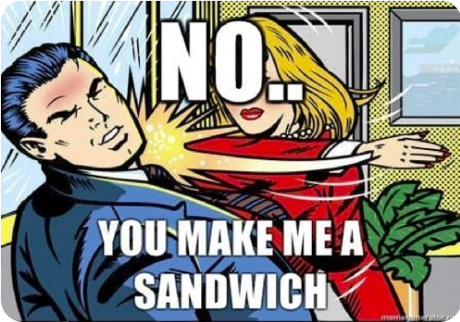
Woman, make me a sandwich let me make you a sandwich. Automatic Neutralisation of Sexist Language
Computer Science
COMP0087 Submission: Group 10

Slide 2
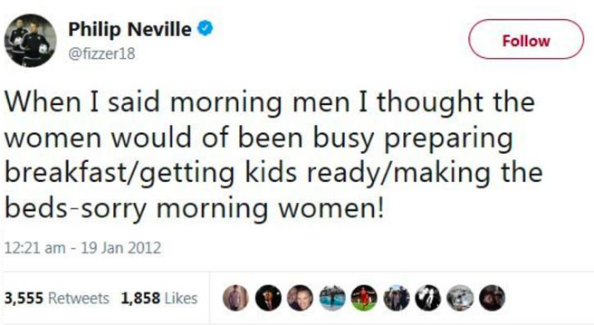


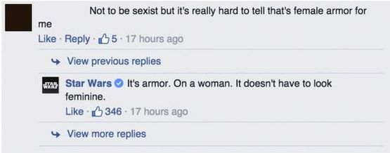
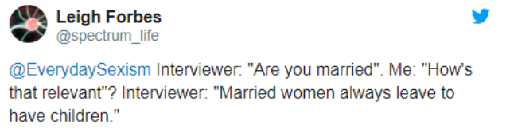
Problem statement
“ Data gathered by Her Game Too surveyed 371 female football fans and 91.9% said they had seen online abuse being directed at other women, while 63.1% said they had been abused online themselves.”
“Approximately 1 in 10 Americans have experienced online harassment specifically because of their gender” (*Duggan, 2017)

Slide 3




Our approach
Formulate the research question
Data pre-processing
Model building
Results & Insights
Formulate the problem and research the domain
Observe and pre-process the data
Build models to answer the research question
Collate the results
Formulate the research question : Neutralising sexist language using NLP
Observe the datasets
Pre-process the data
Manual cleaning and neutralisation
Run inference against the baseline model
Fine tune the pretrained model
Fine tune new model with augmented data
Collate the results from the models
Analyse the obtained results

Slide 4
Datasets
Call me sexist
The Samory et al., 2021^{[1]} created this dataset which consists of sexist tweets and neutralized sentence pairs. It is a combination of multiple datasets:
1) Hostile sexists and Non-sexist tweets
2) tweets with benevolent sexism
3) “Call me sexist” tweets
The gold version of the sexist tweets were generated by Amazon Mechanical Turk Workforce. Upon inspection of the dataset, it was found that many tweets were incorrectly or badly neutralized containing biases such as ageism or racism.
Therefore, the dataset was manually neutralised again by the team, resulting in a new corpus with 2,405 sexist and gold pairs. The remaining un-neutralised 1,302 sexist tweets with no gold examples were used in the data augmentation pipeline.
Workplace Sexism Dataset
Grosz and Conde-Cespedes^{[2]}, 2020 collated this dataset which contains sexist statements from workplace conversations. All 626 sentences were also utilized in the data augmentation pipeline.
[1] Mattia Samory, Indira Sen, Julian Kohne, Fabian Flöck,and Claudia Wagner. 2021. "call me sexist, but...": Revisiting sexism detection using psychologicalscales and adversarial samples. In ICWSM.
[2] Dylan Grosz and Patricia Conde-Cespedes. 2020. Auto-matic detection of sexist statements commonly used at the workplace. In Pacific-Asia Conference on Knowledge Discovery and Data Mining.

Slide 5
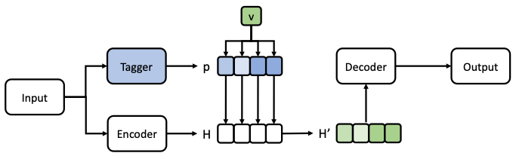



Methods: Model Architechture
Tagger probabilities:
Joint embeddings:
Where,

Slide 6
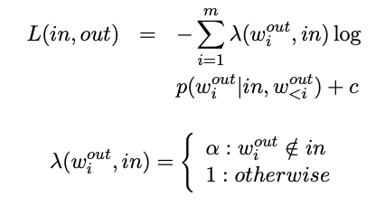
Methods: Loss Function
The aim is to learn the differences between biased and gold text.

Slide 7
Hypotheses
01
BASELINE MODEL
The baseline model created by Pryzant et al., 2020 can neutralise sexist language as it has been trained on data with demographic bias
02
FINETUNING THE BASELINE MODEL
The baseline model can be improved by fine tuning on a dataset of sexist examples with their respective neutralisations.
03
X.
BUILDING A DATA AUGMENTATION PIPELINE
An automatic data augmentation pipeline can be built to create additional training data to improve the finetuned model.
04
EVALUATING NEUTRALISED SENTENCES
Neutralised sentences can be automatically evaluated without human intervention
Reid Pryzant, Richard Diehl Martinez, Nathan Dass, Sadao Kurohashi, Dan Jurafsky, and Diyi Yang. 2020. Automatically neutralizing subjective bias in text. In AAAI

Slide 8
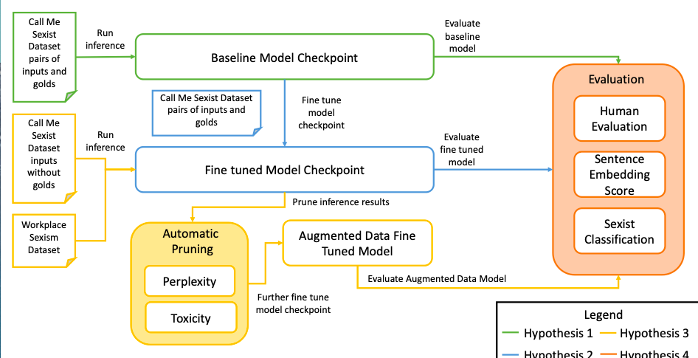
Procedure flowchart

Slide 9
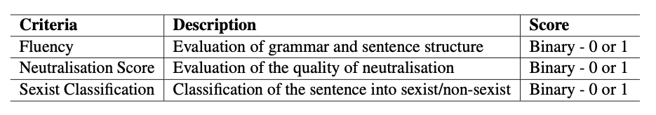
Evaluation metrics
Following Pryzant et al., 2020,^{[1]} the BLEU score and True Hits were used for quantitative evaluation. On top of that we used two novel evaluation methods:
1) Sexism classification using SVM
2) Cosine similarity between embeddings of gold and predicted sentences using sentence transformers
For qualitative assessment, we conducted human evaluation with the following criteria:
[1] Reid Pryzant, Richard Diehl Martinez, Nathan Dass, Sadao Kurohashi, Dan Jurafsky, and Diyi Yang. 2020. Automatically neutralizing subjective bias in text. In AAAI

Slide 10
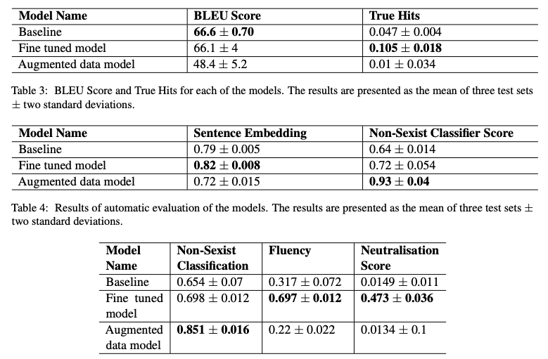
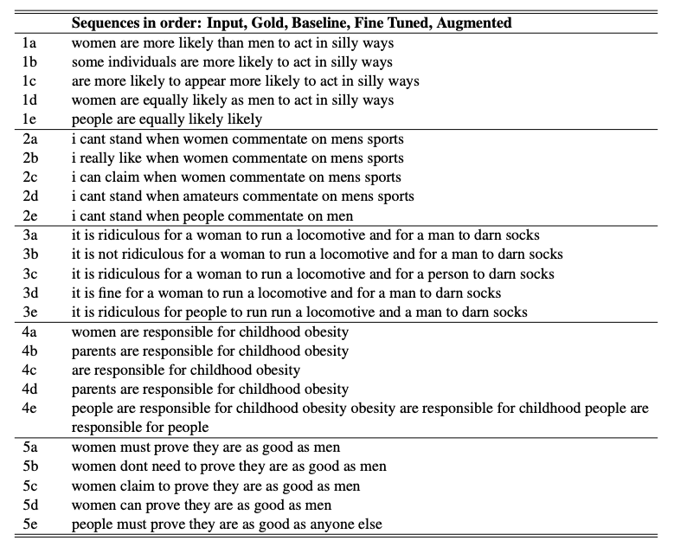
Results
Table 1) BLEU Score and True Hits for each of the models. The results are presented as the mean of three test sets ± two standard deviations.
Table 5
Table 2) Results of automatic evaluation of the models. The results are presented as the mean of three test sets ± two standard deviations.
Table 3) Results of human evaluation. The results are presented as the mean of the results of human evaluation ± two standard deviations.
Table 4) Examples of neutralised sentences for each of the three models for qualitative evaluation

Slide 11
Conclusion
The performance of the baseline model on the task of sexism neutralisation was improved by fine tuning the model with the "Call Me Sexist" dataset
An automated data augmentation pipeline did not result in an improved model performance
A mixture of automatic and human evaluation was needed to conclusively decide which model performed best
Future work:
Additional automatic evaluations metrics and finding the optimal metrics combination
Additional sexism data
Augmented data pipeline improvement

